Slide 1
OO Programming
The details of Java
Notes:
<number>

Slide 2
OO Concepts
Abstraction
Encapsulation
Inheritance
Polymorphism and Dynamic Dispatching
Runtime vs Compile Time

Slide 3
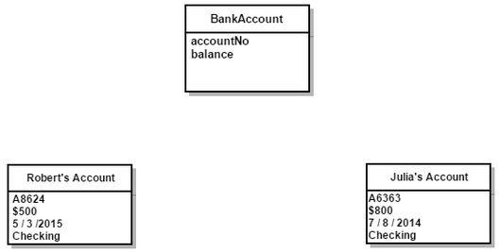

Abstraction
Class vs Instance
Creating abstractions of concepts that we can re-use
Notes:
Photo credit: https://theleancoder.wordpress.com/2015/10/11/the-four-pillars-of-object-oriented-design/
<number>

Slide 4
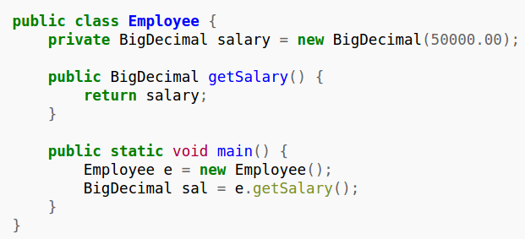
Encapsulation (information Hiding)
Hiding parts of a program in order to create a Standard Interface
Notes:
Photo credit: https://en.wikipedia.org/wiki/Encapsulation_(computer_programming)
<number>

Slide 5
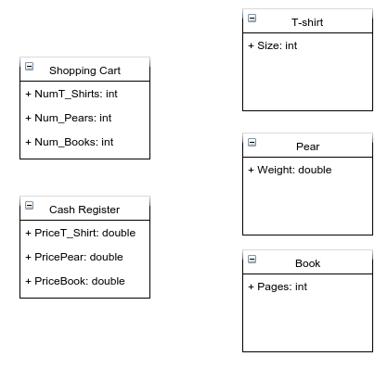
Encapsulation (information Hiding)
Who should have the price attributes?
Notes:
Photo credit:
<number>

Slide 6
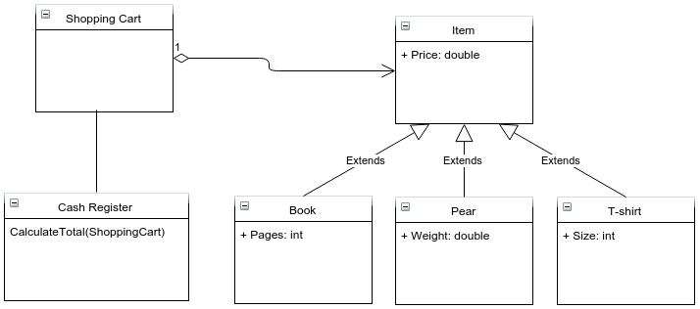
Encapsulation (information Hiding)
Who should have the price attributes?
The information Expert
Notes:
Photo credit:
<number>

Slide 7
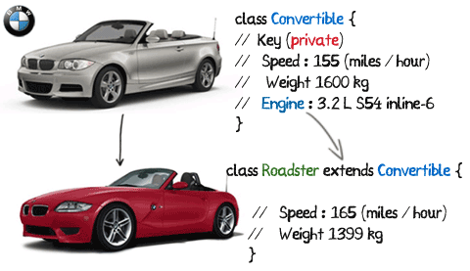
Inheritance
When to use:
Reusing attributes and Methods
Creating abstractions of concepts
Notes:
<number>

Slide 8
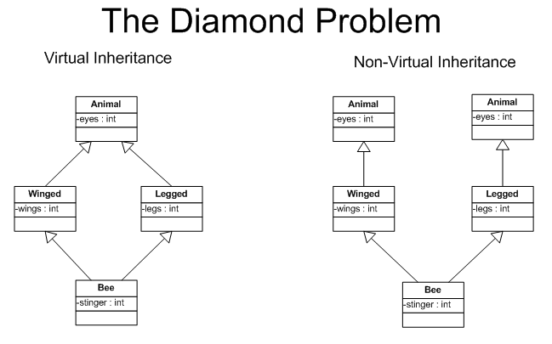
Inheritance Diamond Problem
How can we create a class that can be charged
and paid?
Java will not allow this!
Notes:
Image credit: http://horstmann.com/sjsu/summer2012/unit9/diamond.png
<number>

Slide 9
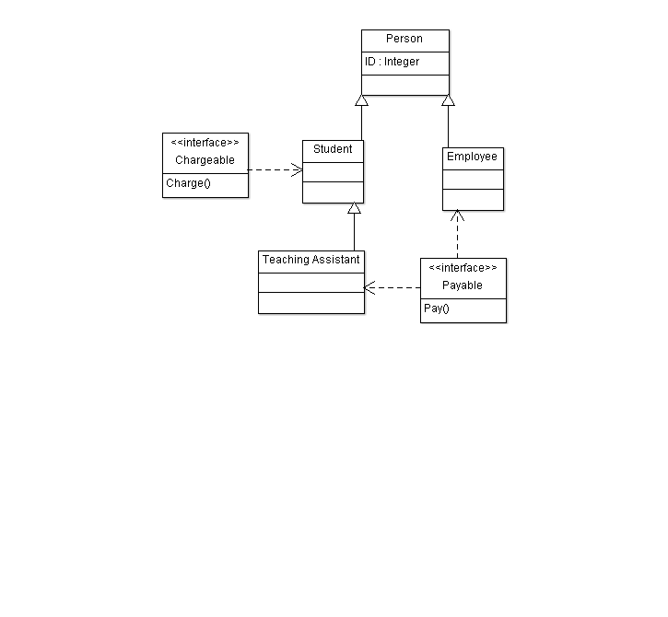
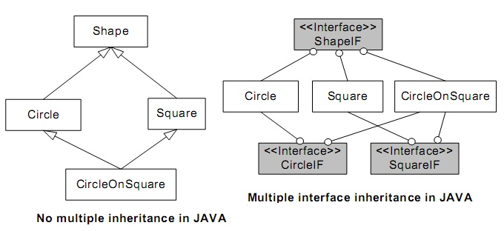
Interfaces
Standardizing a method across multiple classes
Notes:
<number>

Slide 10
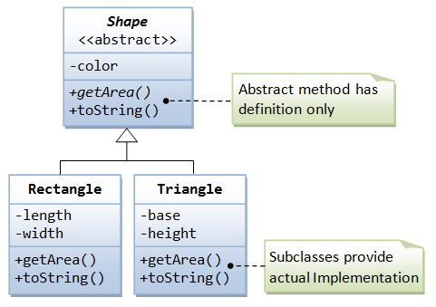
Abstract class
Problem: We want to reuse properties across many classes. The result does not exist in real life. Can we represent that abstraction in code?
Solution: Abstract class

Slide 11
Dynamic Method dispatching
Problem: Want to create multiple enemies with the same interface but have different implementations
Solution: Dynamic method Dispatching
See code example in the repo if you did not attend tutorial.

Slide 12
Runtime vs Compile time
When is Compile time? When is Runtime? What does it mean?
Mistakes happen when you are:
writing code
Compiling
Executing code
Understanding where in the cycle the error happens helps diagnose the issue.
Is there an example?
Yes, see the code on the repo if you did not attend the tutorial

Slide 13
Concept Questions
Will an IDE catch compile time errors?
Will an IDE catch runtime errors?
Is there a difference between an abstract class and an interface?

Slide 14
Deliverables
Software Architecture Document due
Notes:
<number>

Slide 15
References
Runtime vs compile time explanation: https://www.youtube.com/watch?v=QmvmZqpthbc
Dynamic method dispatching: https://www.youtube.com/watch?v=PK2mZ39AAzE
OO blog: https://theleancoder.wordpress.com/2015/10/11/the-four-pillars-of-object-oriented-design/

